Slide 1
Chapter 11: Random Forests
Hands-On Machine Learning with R
R Ladies Den Bosch

Slide 2
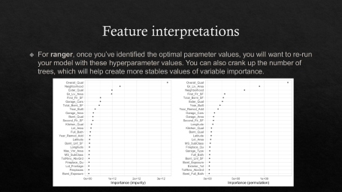
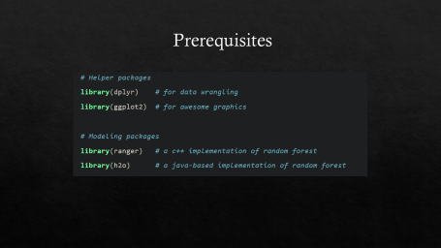
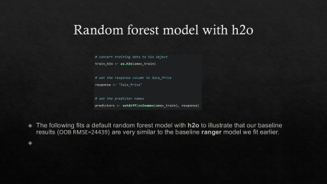
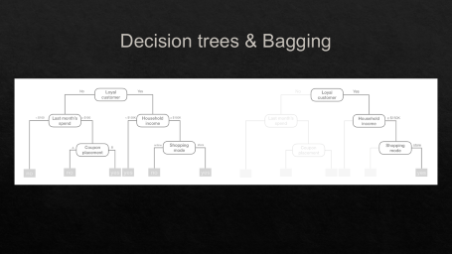
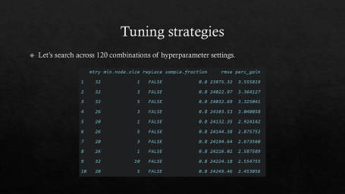
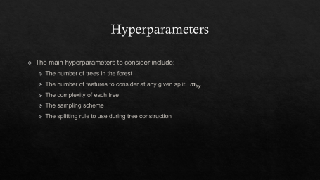
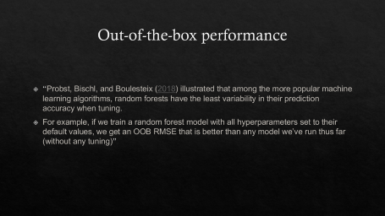
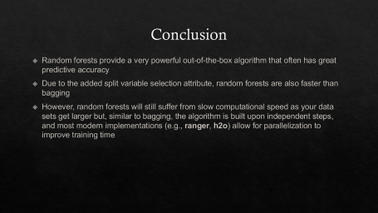
Summary

Slide 3
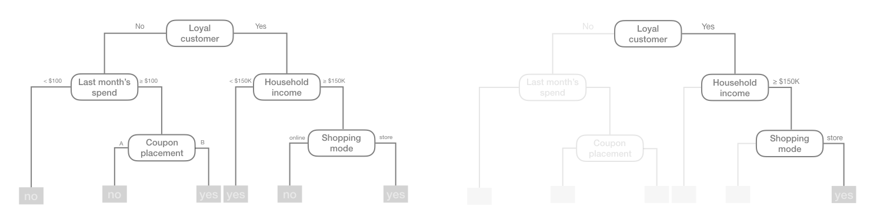
Decision trees & Bagging

Slide 4
Downfalls of Decision Trees & Bagging
Disadvantages of Decision Trees
  A small change in the data can result in a major change in the structure of the Tree
  They are often relatively inaccurate
Disadvantages of Bagging (Bootstrap Aggregation):
  Tree correlations (Most Trees end up looking similair)
  resultant model can experience lots of bias → introduces a loss of interpretability of a model
Notes:
Bagging trees introduces a random component into the tree building process by building many trees on bootstrapped copies of the training data. Bagging then aggregates the predictions across all the trees; this aggregation reduces the variance of the overall procedure and results in improved predictive performance

Slide 5
Random Forest vs. Bagging
“Random forests help to reduce tree correlation by injecting more randomness into the tree-growing process. More specifically, while growing a decision tree during the bagging process, random forests perform split-variable randomization”

Slide 6
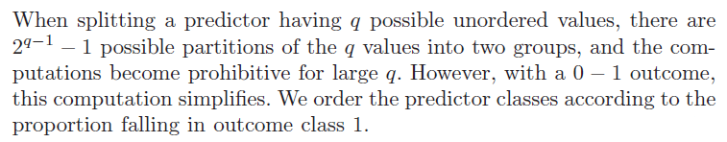
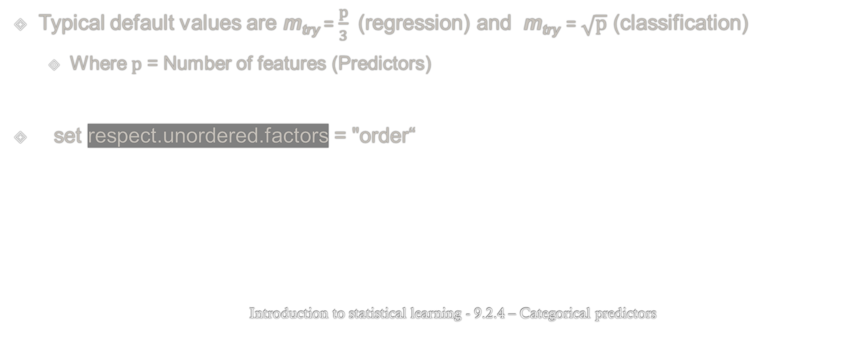
Random Forest vs. Bagging
Typical default values are m_{try} = $\frac{p}{3}$ (regression) and m_{try} = $\sqrt{p}$ (classification)
  Where p = Number of features (Predictors)
set respect.unordered.factors = "order“
                Introduction to statistical learning - 9.2.4 – Categorical predictors

Slide 7
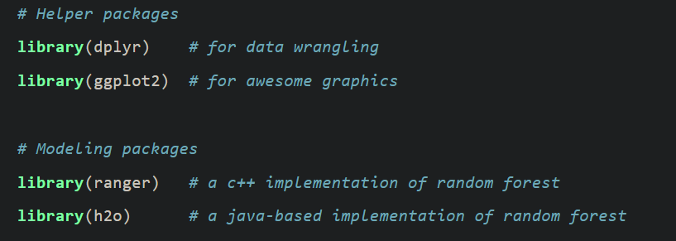
Prerequisites
Notes:
R interface for 'H2O', the scalable open source machine learning platform that offers parallelized implementations of many supervised and unsupervised machine learning algorithms such as Generalized Linear Models (GLM), Gradient Boosting Machines (including XGBoost), Random Forests, Deep Neural Networks (Deep Learning), Stacked Ensembles, Naive Bayes, Generalized Additive Models (GAM), ANOVA GLM, Cox Proportional Hazards, K-Means, PCA, ModelSelection, Word2Vec, as well as a fully automatic machine learning algorithm (H2O AutoML).

Slide 8
Out-of-the-box performance
“Probst, Bischl, and Boulesteix (2018) illustrated that among the more popular machine learning algorithms, random forests have the least variability in their prediction accuracy when tuning.
For example, if we train a random forest model with all hyperparameters set to their default values, we get an OOB RMSE that is better than any model we’ve run thus far (without any tuning)”

Slide 9
The Ames Housing Data
The data set contains information on 2,930 properties in Ames, Iowa, including columns related to:
  house characteristics (bedrooms, garage, fireplace, pool, porch, etc.)
  location (neighborhood)
  lot information (zoning, shape, size, etc.)
  ratings of condition and quality
  sale price

Slide 10
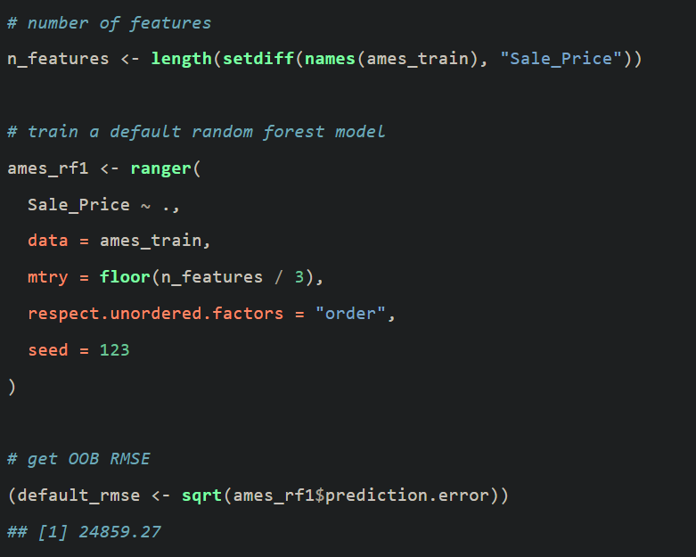
Out-of-the-box performance

Slide 11
Hyperparameters
The main hyperparameters to consider include:
  The number of trees in the forest
  The number of features to consider at any given split: m_{try}
  The complexity of each tree
  The sampling scheme
  The splitting rule to use during tree construction

Slide 12
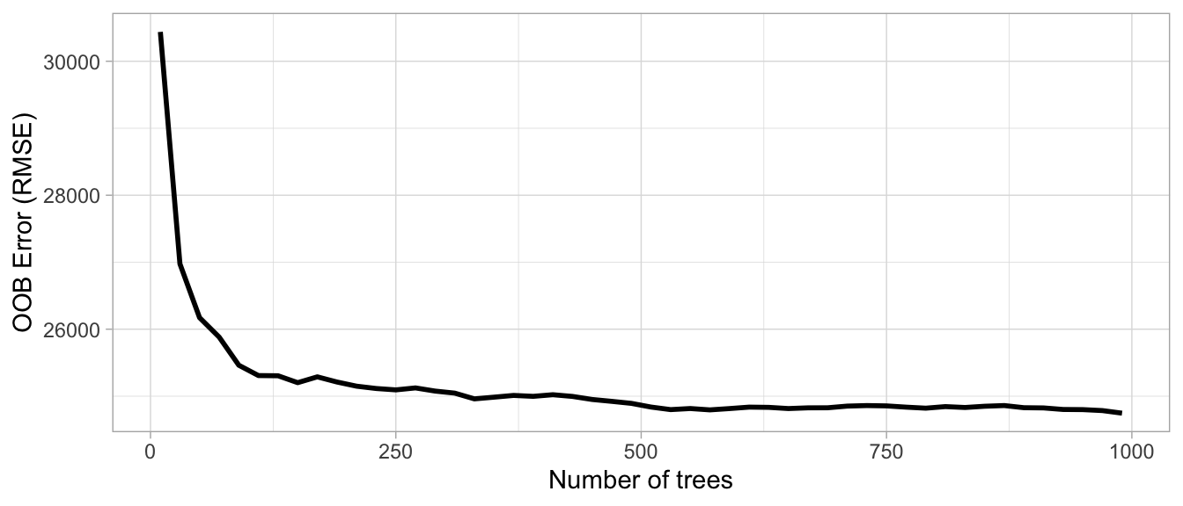
number of trees
Start with p×10 trees and adjust as necessary
The Ames data has 80 features and starting with 10 times the number of features typically ensures the error estimate converges.

Slide 13
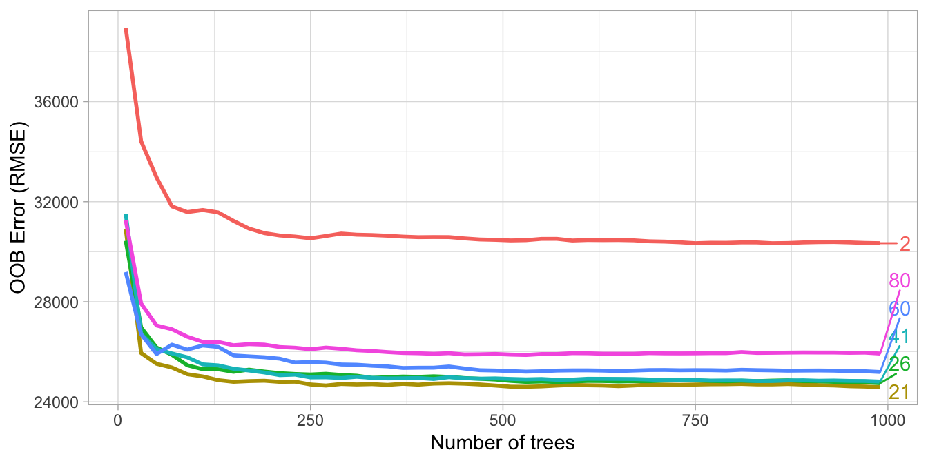
m_{try}
Start with five evenly spaced values of m_{try} across the range 2-p centered at the recommended default as illustrated in Figure
For the Ames data, an m_{try} value slightly lower (21) than the default (26) improves performance.

Slide 14
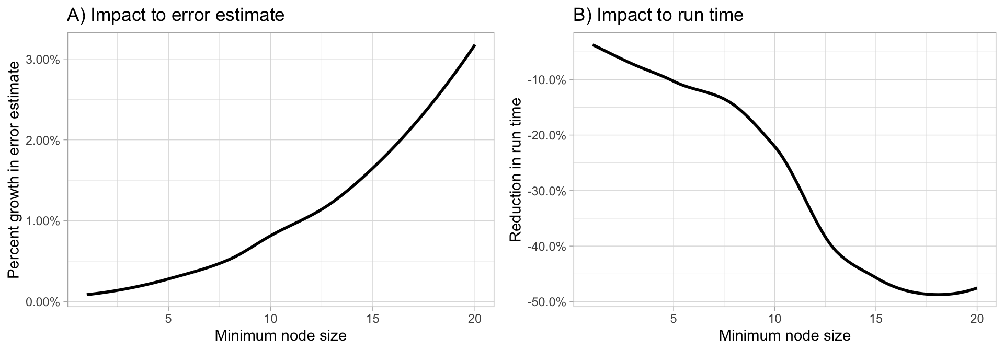
Tree complexity
When adjusting node size start with three values between 1–10 and adjust depending on impact to accuracy and run time.
Increasing node size to reduce tree complexity will often have a larger impact on computation speed (right) than on your error estimate.

Slide 15
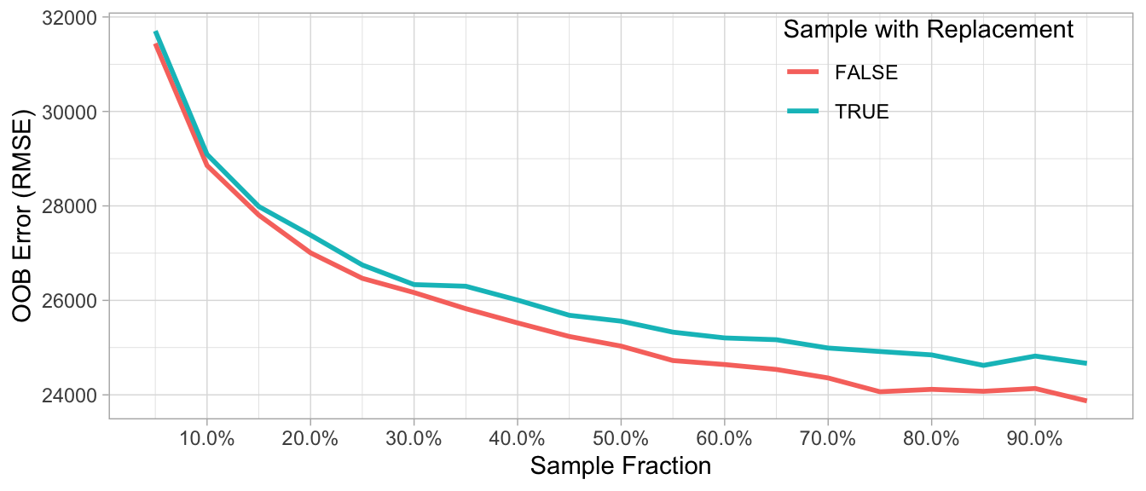
Sampling scheme
Assess 3–4 values of sample sizes ranging from 25%–100% and if you have unbalanced categorical features try sampling without replacement.
The Ames data has several imbalanced categorical features such as neighborhood, zoning, overall quality, and more. Consequently, sampling without replacement appears to improve performance as it leads to less biased split variable selection and more uncorrelated trees.

Slide 16
Split rule
If you need to increase computation time, significantly try completely randomized trees; however, be sure to assess predictive accuracy to traditional split rules as this approach often has a negative impact on your loss function.
Notes:
the default splitting rule during random forests tree building consists of selecting, out of all splits of the candidate variables, the split that minimizes the Gini impurity (in the case of classification) and the SSE (in case of regression). However, these default splitting rules favor the selection of features with many possible splits over variables with fewer splits

Slide 17
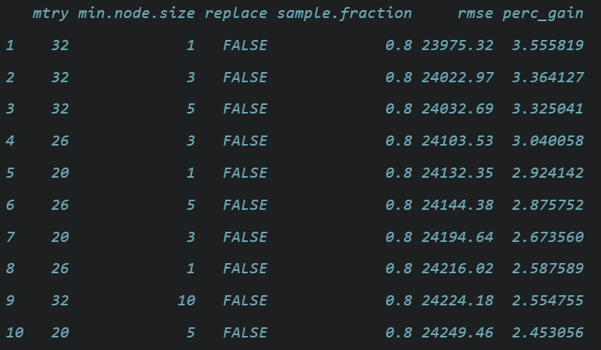
Tuning strategies
Let’s search across 120 combinations of hyperparameter settings.
Notes:
If we look at the results, we see that the top 10 models are all near or below an RMSE of 24000 (a 2.5%–3.5% improvement over our baseline model). In these results, the default mtry value of ⌊# features/3⌋=26 is nearly sufficient and smaller node sizes (deeper trees) perform best. What stands out the most is that taking less than 100% sample rate and sampling without replacement consistently performs best. Sampling less than 100% adds additional randomness in the procedure, which helps to further de-correlate the trees. Sampling without replacement likely improves performance because this data has a lot of high cardinality categorical features that are imbalanced.

Slide 18
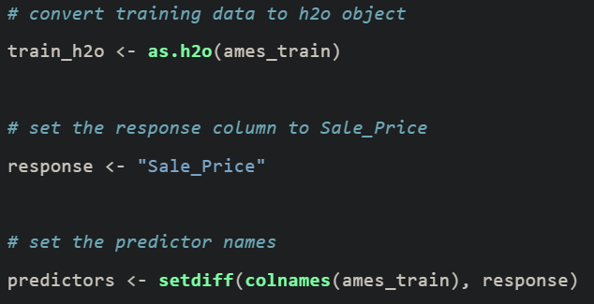
Random forest model with h2o
The following fits a default random forest model with h2o to illustrate that our baseline results (OOB RMSE=24439) are very similar to the baseline ranger model we fit earlier.

Slide 19
Tuning strategies with h2o
The best model (max_depth = 30, min_rows = 1, mtries = 20, and sample_rate = 0.8) achieved an OOB RMSE of 23932. So, although our random search assessed about 30% of the number of models as a full grid search would, the more efficient random search found a near-optimal model within the specified time constraint.

Slide 20
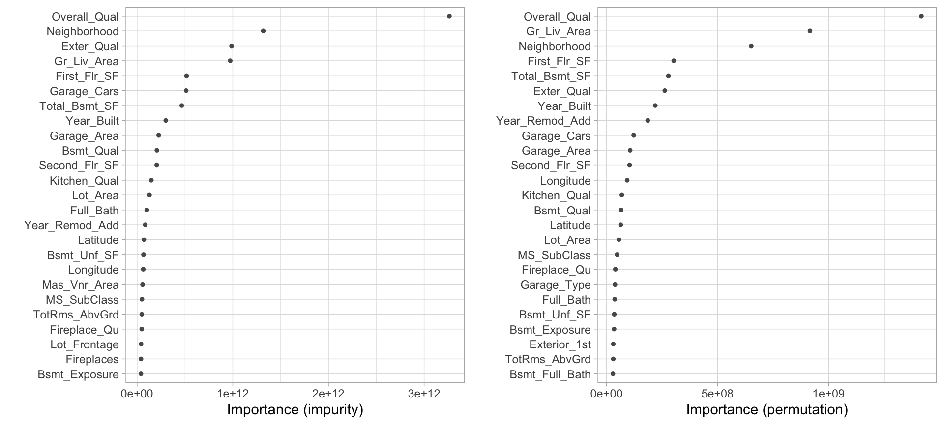
Feature interpretations
For ranger, once you’ve identified the optimal parameter values, you will want to re-run your model with these hyperparameter values. You can also crank up the number of trees, which will help create more stables values of variable importance.

Slide 21
Conclusion
Random forests provide a very powerful out-of-the-box algorithm that often has great predictive accuracy
Due to the added split variable selection attribute, random forests are also faster than bagging
However, random forests will still suffer from slow computational speed as your data sets get larger but, similar to bagging, the algorithm is built upon independent steps, and most modern implementations (e.g., ranger, h2o) allow for parallelization to improve training time

Slide 22
Thank you

